Slide 1
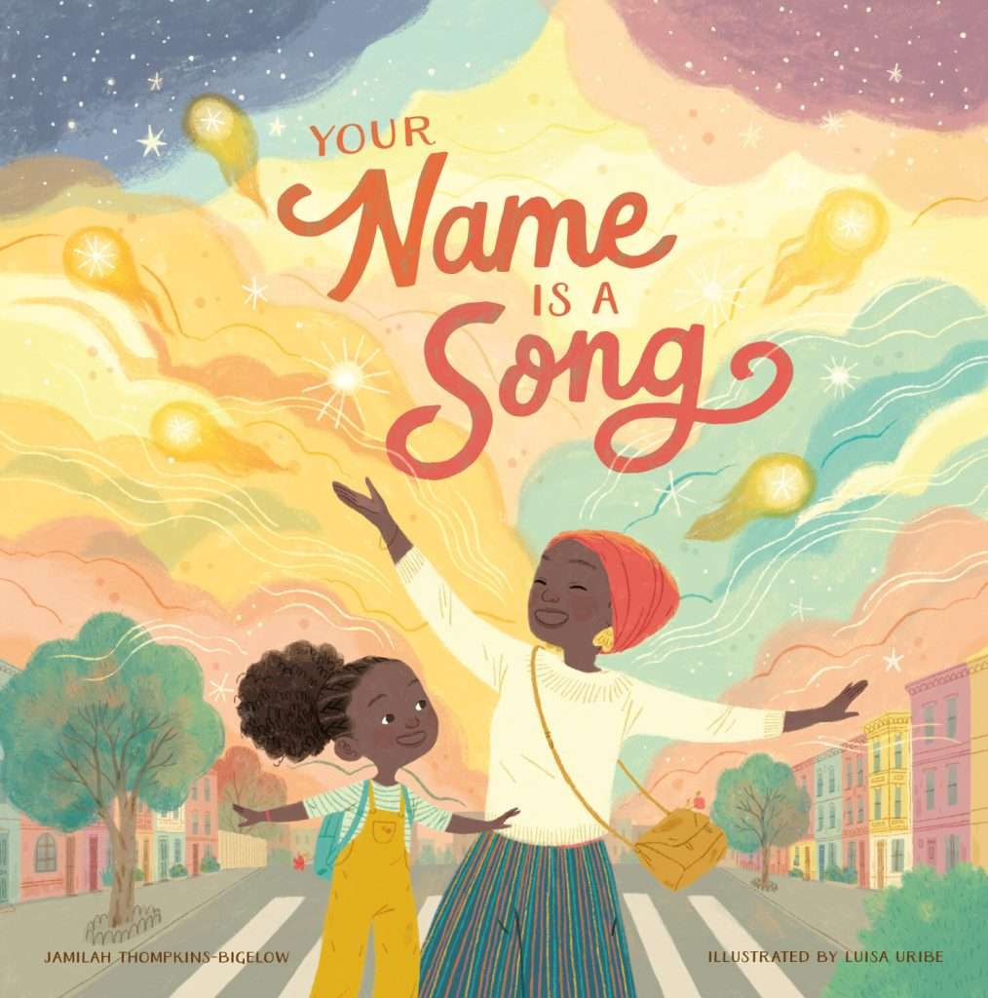
COSTUME
PRESENTATION
ABIGAIL GEARHART

Slide 2
What is the story about?
Frustrated by a day full of teachers and classmates mispronouncing her beautiful name, a little girl tells her mother she never wants to come back to school. In response, the girl’s mother teaches her about the musicality of African, Asian, Black-American, Latinx, and Middle Eastern names on their lyrical walk home through the city. Empowered by this newfound understanding, the young girl is ready to return the next day to share her knowledge with her class. Your Name is a Song is a celebration to remind all of us about the beauty, history, and magic behind names.

Slide 3
THE AUTHOR
Jamilah Thompkins-Bigelow, M.S.Ed, is a Philadelphia-based educator and children’s book author. A curriculum writer and former English teacher, she has educated children and teens in traditional and alternative learning settings for 15 years. Her picture books and short stories, which feature young Black and Muslim protagonists, have been recognized as the best in children’s literature by Time Magazine, Read Across America, and NPR.

Slide 4
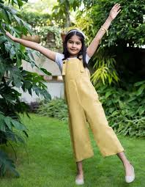
KORA-jalimuso

Slide 5
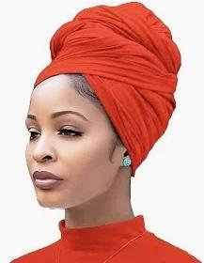
Momma

Slide 6
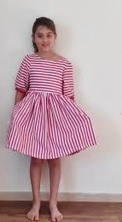
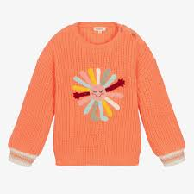
Ashley/Lunch girl 2/ ensemble 3

Slide 7
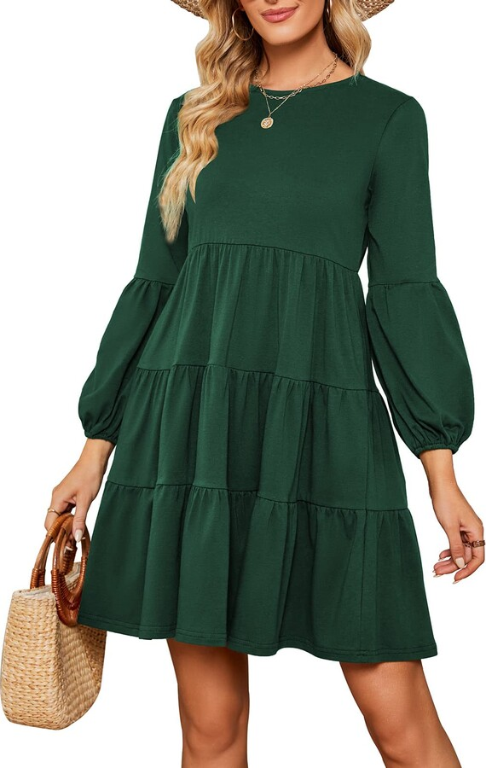
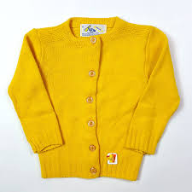
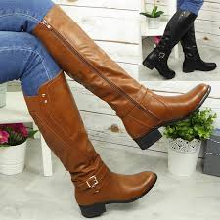
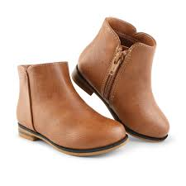
Ms. Anderson/ lunch girl 1/ ensemble 4

Slide 8
Vic/ lunch boy 2/ pick-up kid 1/ ensemble 1

Slide 9
ben/ lunch boy 1/ pick- up kid 2/ ensemble 2

